Slide 1
Banking Data Analysis in SQL
Balu P

Slide 2
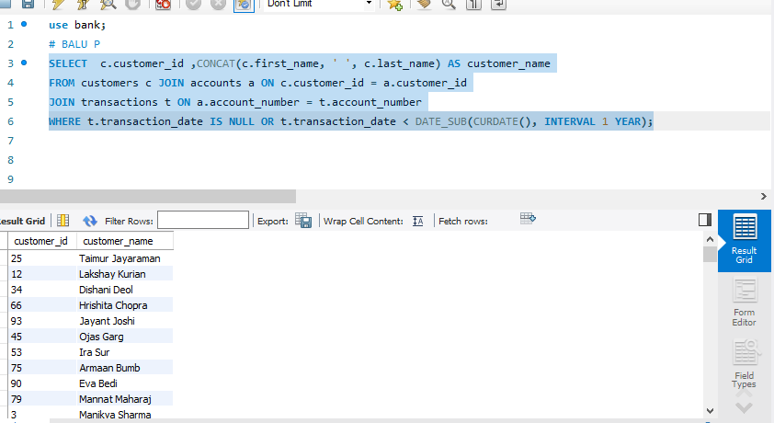
Write a query to list all customers who haven’t made any transactions in the last year. How can we make them active again? Provide appropriate region

Slide 3
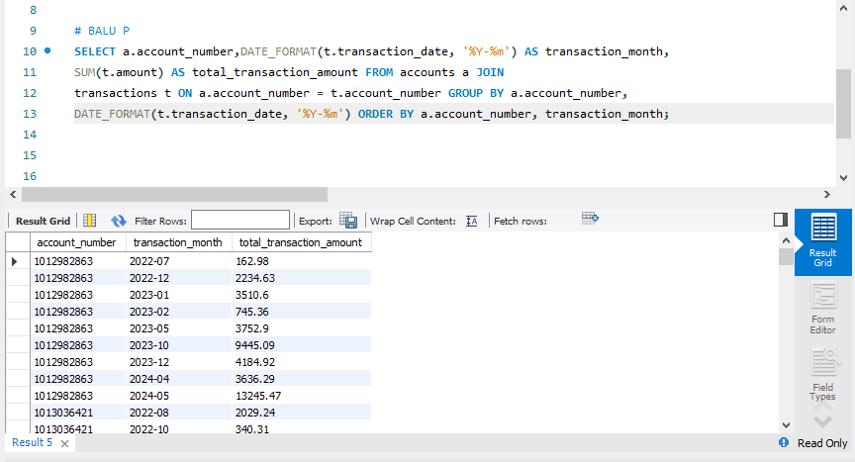
Summarize the total transaction amount per account per month.

Slide 4
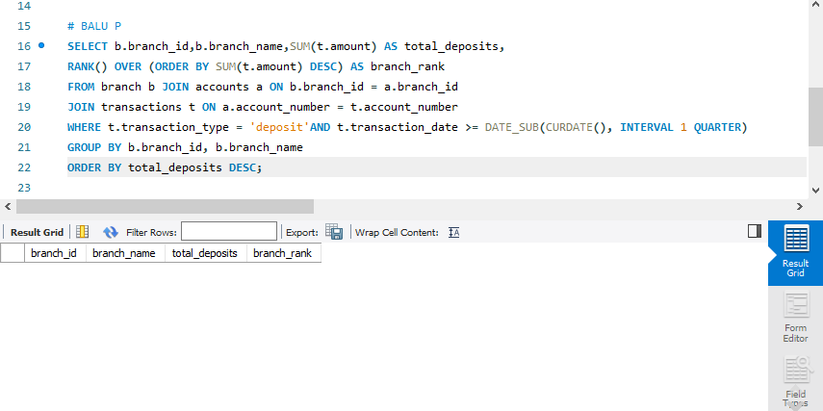
Rank branches based on the total amount of deposits made in the last quarter.

Slide 5
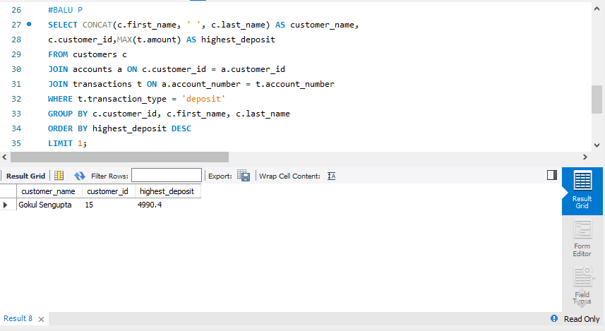
Find the name of the customer who has deposited the highest amount.

Slide 6
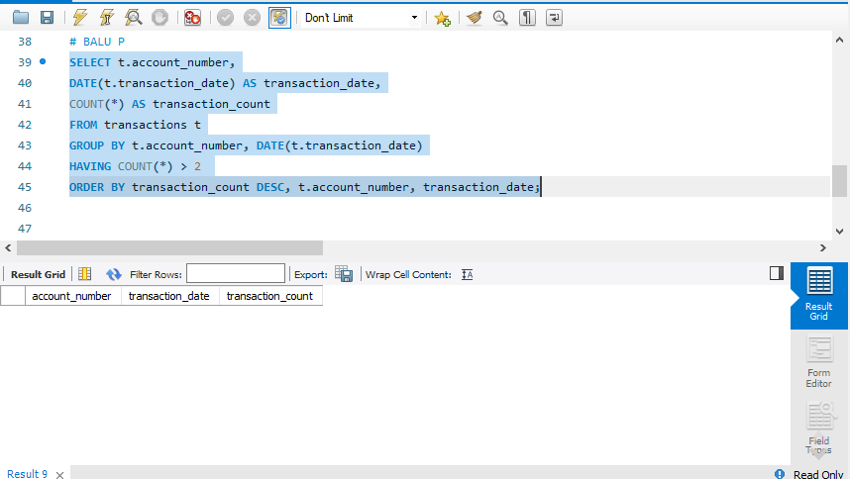
Identify any accounts that have made more than two transactions in a single day, which could indicate fraudulent activity. How can you verify any fraudulent transaction?

Slide 7
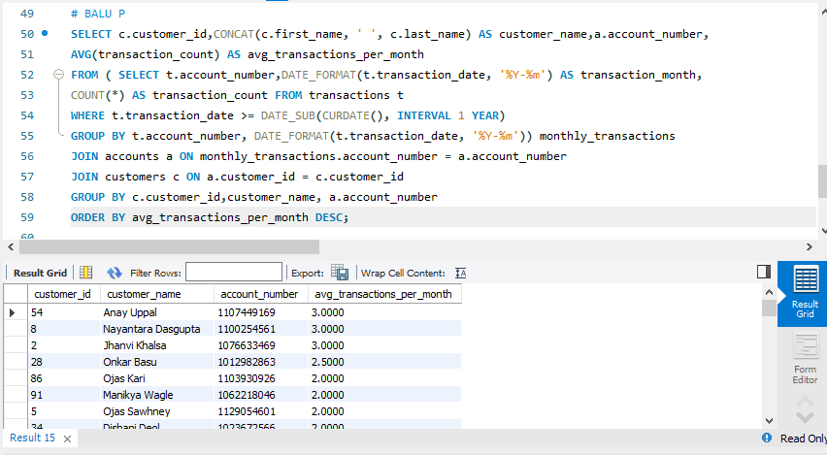
Calculate the average number of transactions per customer per account per month over the last year.

Slide 8
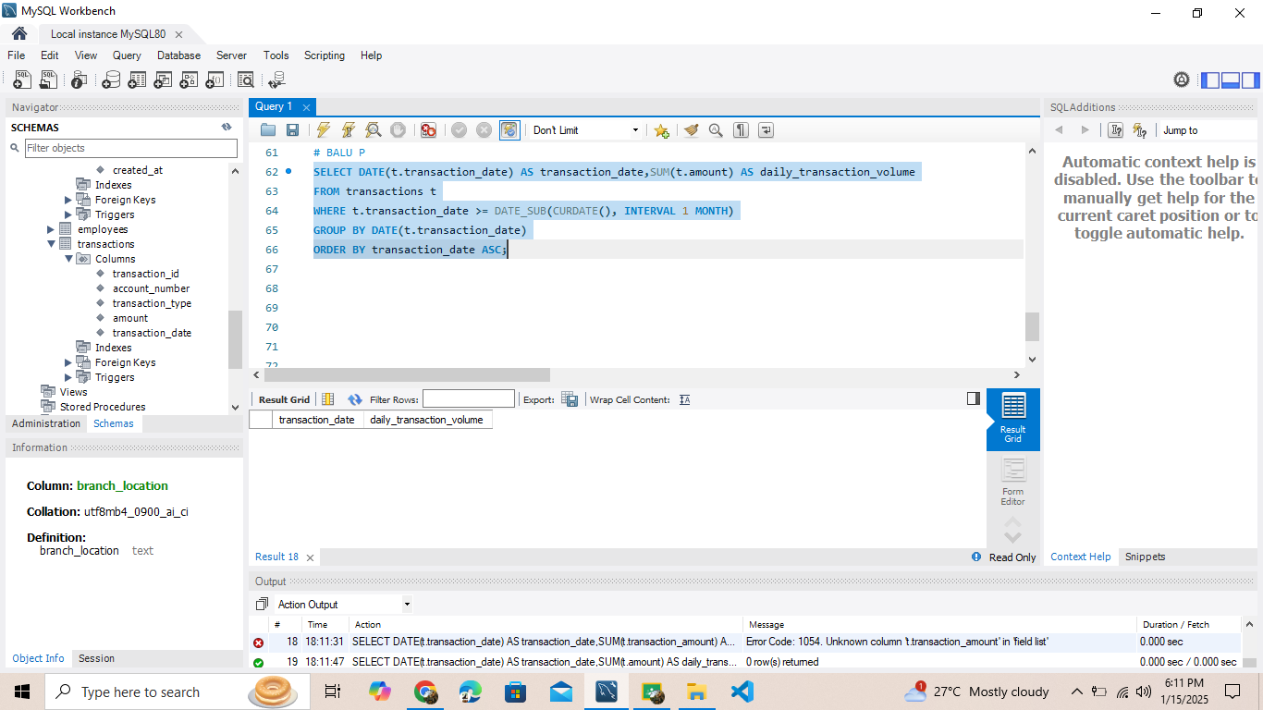
Write a query to find the daily transaction volume (total amount of all transactions) for the past month.

Slide 9
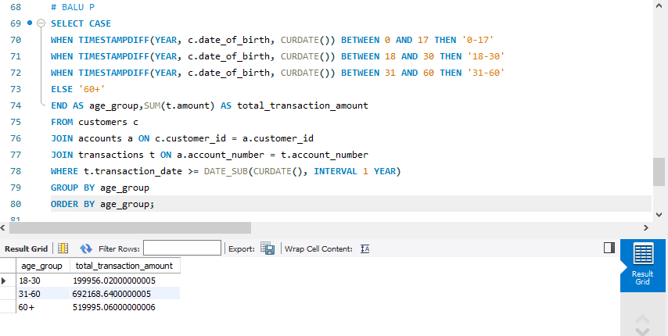
Calculate the total transaction amount performed by each age group in the past year. (Age groups: 0-17, 18-30, 31-60, 60+)

Slide 10
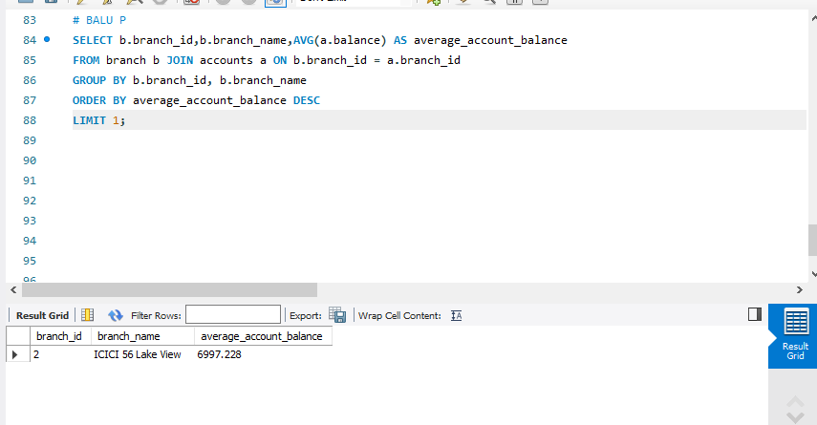
Find the branch with the highest average account balance.

Slide 11
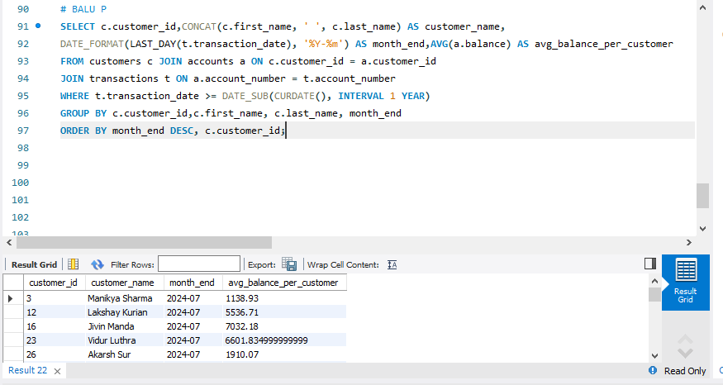
Calculate the average balance per customer at the end of each month in last year.

Slide 12
THANK YOU

